Slide 1
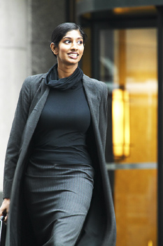
3-1 FORM AND BASIC MEANING OF THE SIMPLE PRESENT TENSE
What does Lala do in the morning?
She walks.

Slide 2
3-1 FORM AND BASIC MEANING OF THE SIMPLE PRESENT TENSE
Who walks in the morning?
Lala does.
B03 - 9a

Slide 3
5-2 YES/NO QUESTIONS AND INFORMATION
QUESTIONS
(QUESTION
WORD)
HELPING VERB
SUBJECT
MAIN VERB
(REST OF
SENTENCE)
(a) Does he work in Beijing?
yes/no question
(b) Where does he work ?
information question

Slide 4
5-2 YES/NO QUESTIONS AND INFORMATION
QUESTIONS
(QUESTION
WORD)
HELPING VERB
SUBJECT
MAIN VERB
(REST OF
SENTENCE)
(k) Who lives with you?
(l) What flies ?

Slide 5
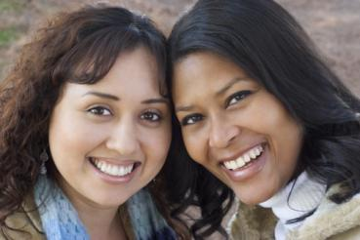
5-2 LET’S PRACTICE
INFORMATION QUESTION
Who _______________
lives with Juana?
ANSWER
Juana’s friend lives with her.

Slide 6
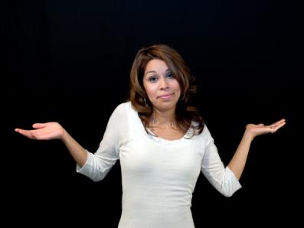
5-4 QUESTIONS WITH WHO, WHO(M), AND WHAT
Who works?
I don´t.

Slide 7
5-4 QUESTIONS WITH WHO, WHO(M), AND WHAT
QUESTION
ANSWER
(a) Who speaks Chinese?
I do.
(b) Who teaches B02 at 5pm?
Mr. Diaz does.
I don´t.
who subject

Slide 8
5-4 QUESTIONS WITH WHO, WHO(M), AND WHAT
QUESTION
ANSWER
(a) Who has a brother?
He does.
(c) What runs fast?
A cheetah does.
who, what subject
Do(Aux) not used
CORRECT: Who sings?
INCORRECT: Who does sing?

Slide 9
3-1 Let’s Practice
watches
Who _______ television in the morning?
watches
do you watch

Slide 10
3-1 Let’s Practice
do you watch
What ____________ on T.V. at night?
do you watch
watches

Slide 11
3-1 Let’s Practice
sleeps
Who _______ late?
do you sleep
sleeps

Slide 12
3-1 Let’s Practice
has
Who _______ a skateboard?
do you have
has
Kevin does.

Slide 13
3-1 Let’s Practice
costs
what ______ $300?
costs
does it cost
The new phone does

Slide 14
3-1 Let’s Practice
costs
what ______ $300?
costs
does it cost
The new phone does

Slide 15
3-5 Let’s Practice
watch
Who ______ this TV show?
watches
I do.

Slide 16
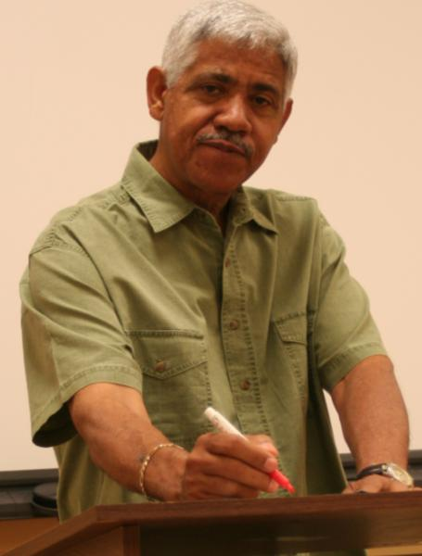
3-5 Let’s Practice
teach
Who _______ math?
teaches
Gerardo does.

Slide 17
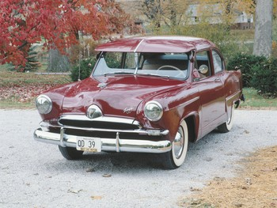
3-5 Let’s Practice
wash
washes
Who always _______ his car?

Slide 18
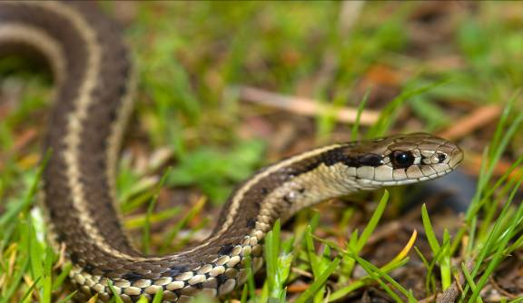
3-9 Let’s Practice
Who _____ snakes.
has
have
My friend does.

Slide 19
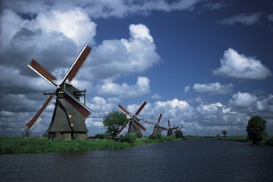
3-9 Let’s Practice
Who ___________ Dutch?
speaks
speak

Slide 20
3-13 Let’s Practice
- does do
do
Who ____ you live with?

Slide 21
3-13 Let’s Practice
works do does do you work
works
Who _____ at ICPNA?

Slide 22
3-13 Let’s Practice
does does he study studies study
does he study
When ____________ for a test?

Slide 23
3-13 Let’s Practice
does it meow meows does meow do meow
meows
What _______?
A cat does

